Slide 1
Drowning Detection Using Yolo V5
ICRL-1001-22

Slide 2
Problem Statement
Research Methodology
Result
Outline

Slide 3
Problem Statement
1.

Slide 4
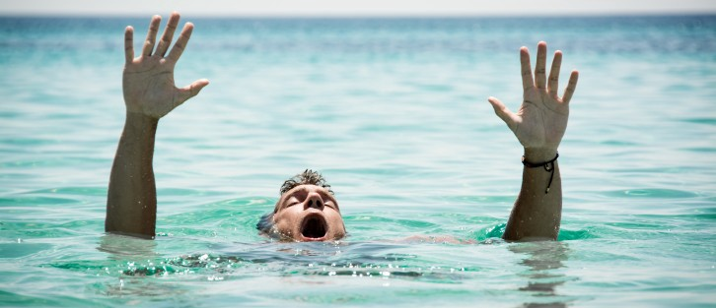
Introduction
Drowning Detection System aims to detect the drowning persons in the swimming area.
It helps the management for monitoring the persons and timey rescue them.

Slide 5
Research Focus
Find Robust Deep Learning Model for the Detection of Drowning Persons in swimming area.

Slide 6
RESEARCH METHODOLOGY
2.

Slide 7
Research Methodology
Dataset
Preprocessing Step
Train Test Split
Training Phase
Evaluation Phase
Research
Methodology

Slide 8
Dataset
Use Lifeguard dataset from YouTube.
Dataset is based on 72 videos.
Video Length: 1-2 minutes

Slide 9
Preprocessing
Extract Image Frames from Videos
Annotate the Extracted Image Frame
Annotation Criteria
Drowning (If Object Body is in Water up to Neck)
Not Drowning (If Object Body is in Water below the Neck)

Slide 10
Train Test Split
Split Dataset into training and Testing Set
Split data with 70 and 30 ratio.
Samples in Training and Testing Set.
Training Set (n=250)
Testing Set (n=30)

Slide 11
Training Phase
Use Training Set for the training of the models.
Train the Following Machine Learning models:
Yolo V5
Use the testing set for the evaluation of the train models.

Slide 12
Evaluation Measures
Evaluation Measures
1. Mean Absolute Error (MAE)
2. Mean Squared Error (MSE)
3. Root Mean Squared Error (RMSE)

Slide 13
Results
3.

Slide 14
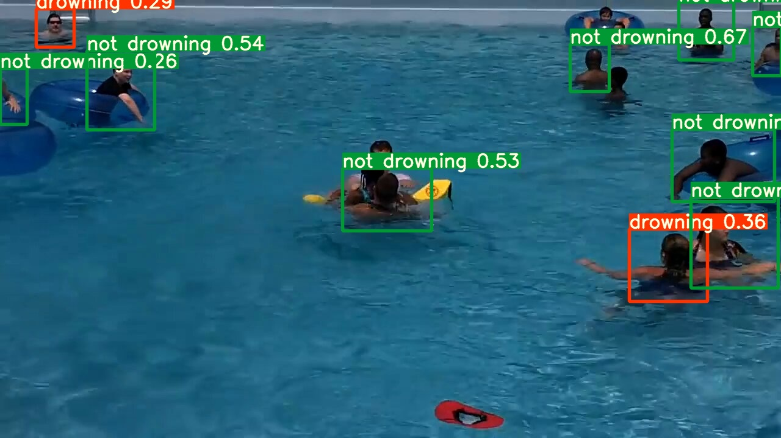
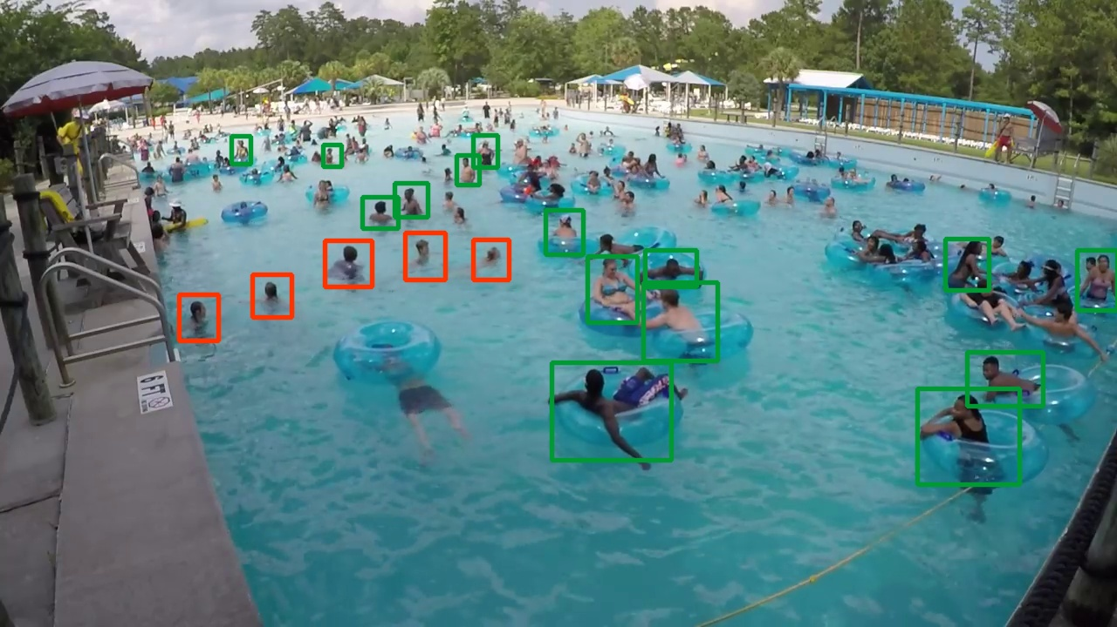
Model Results

Slide 15
Thank You

